Slide 1
DATA VISUALIZATION MEETUP
By Nelda Limilimi

Slide 2

Who is Nelda?
Full Name: Nelda Limilimi
Age: I am a woman
Status: Single
Where can I be found?
Twitter: @nlimilimi
Facebook: Nelda Limilimi
NOW
Communications coordinator at Wefarm Limited
IF NOT WORKING,
Facilitating teenagers at Watoto
Trying to become a better data analyst
Hobbies
Travelling
Reading novels now books
Dancing
Sleeping
Previously a software engineer at Makerere
Looking out for different food recipes
Joking and laughing at people

Slide 3
Expectations
Data visualization knowledge
Interested in improving data visualization skills
Let’s add…..

Slide 4
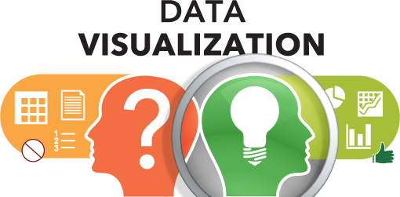
Data visualization is the graphical representation of information and data. By using visual elements like charts, graphs, and maps

Slide 5
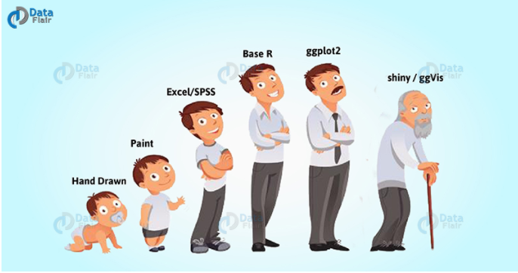

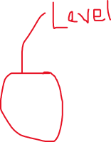

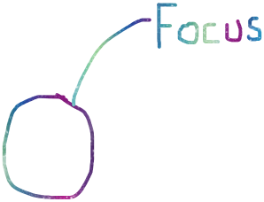
Evolution of data visualization

Slide 6
Data visualization in R? (Tell your story using visuals)
Why R?
R and its many available packages provide many different forms of visualization for nearly every scenario
It provides clear understanding of patterns in data
Also it has an ability to detect hidden structures in data
Formats
Base R (plot(), pie() etc)
ggplot2 (Main focus today)
Shiny/ggVis

Slide 7
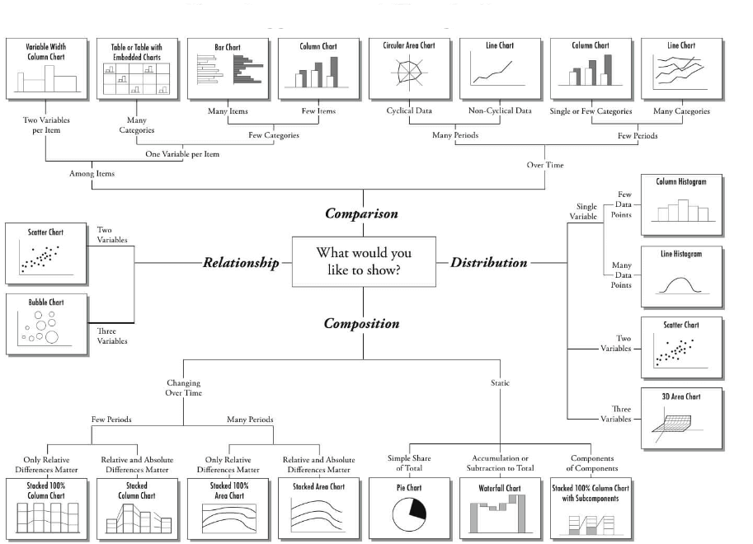
COMMON DISPLAY FORMATS
Selecting the ideal chart types
Determinants
No of variables
Data points to display
Scope of work
Basic Visualization charts
Histogram
Bar / Line Chart
Box plot
Scatter plot
Advanced Visualization
Heat Map
Mosaic Map
Map Visualization
3D Graphs
Correlogram

Slide 8
Basic visualization charts

Slide 9
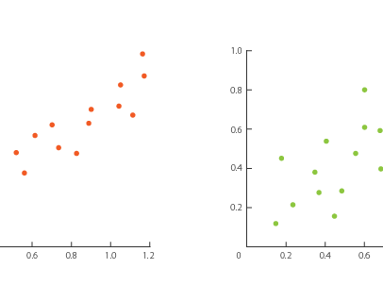
Scatter Plot
Scatter plots help in visualizing data easily and for simple data inspection
To see the relationship between two continuous variables.

Slide 10
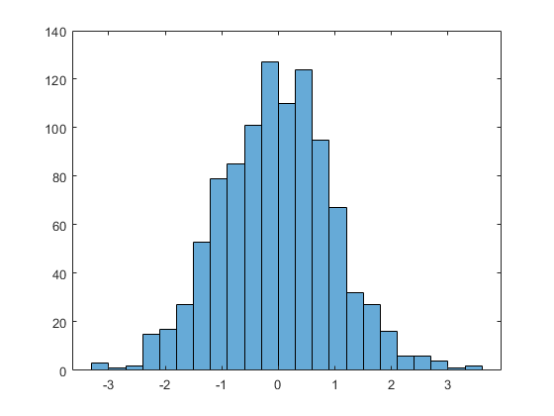
Histogram
A histogram is used to plot continuous variables.
Also, It helps to break the data into bins and shows frequency distribution of these bins. Thus, we can always change the bin size and see the effect it has on visualization.

Slide 11
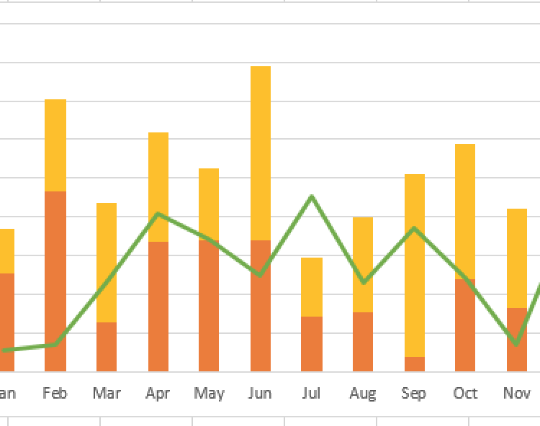
Bar/ Stack Bar/Line Chart
We use Bar charts to plot a categorical variable
Stacked bar chart is an advanced version of bar chart, used for visualizing a combination of categorical variables
Line Charts are commonly preferred when we are to analyze a trend spread over a time period.
.

Slide 12
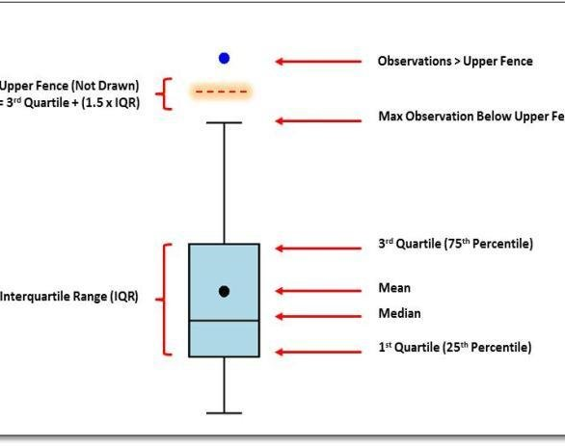
Box Plot
Box Plots are used to plot a combination of categorical and continuous variables.
Also, used for visualizing the spread of the data and detect outliers.
Moreover, it shows five statistically significant numbers; the minimum; the 25th percentile; the median; the 75th percentile and the maximum.

Slide 13
Advanced visualization charts

Slide 14
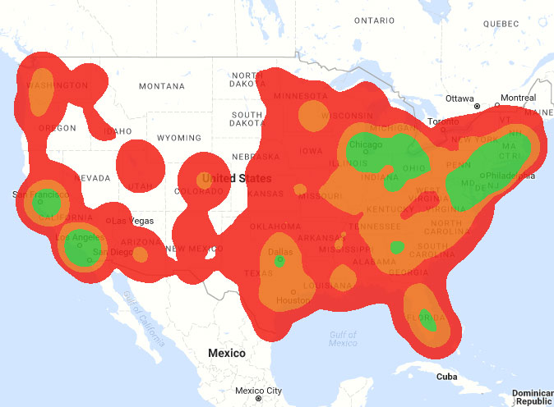
Heat Map
We use it for an intensity of colors.
It is also used to display a relationship between two or three or many variables in a two-dimensional image.
It allows us to explore two dimensions of the axis and the third dimension by an intensity of color.

Slide 15
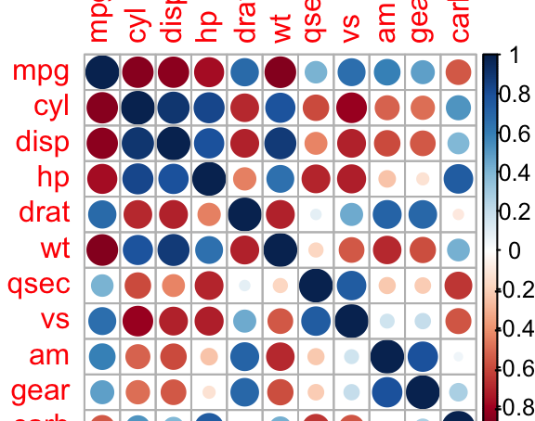
Correlogram
We use it to test the level of correlation and also among the variable available in the dataset.
Thus, the cells of the matrix can be shaded or colored to show the co-relation value.

Slide 16
Others viz charts include;
Mosaic maps
Area plots
3D graphs

Slide 17
Dos & Don’ts of visualization
Do’s
Don'ts
Don’t try to add too much into one plot…keep it simple
Don’t add color unnecessarily unless it provides a specific function
Avoid high contrast colors (red/green or blue/yellow)
Don’t use 3D charts. They can make it hard to discern or perceive the actual information.
Avoid ornamentation (shadowing, extra illustration, etc.)
Avoid more than 6 categorical colors in a layout unless you looking at continuous data.
Keep fonts simple (avoid unnecessary bold or italicization)
Don’t try to compare too many categories or data types in one chart
Label appropriately and legibly, including axes, and use text to highlight important bits
Use one color to represent each category, consider colorblind/BW friendly palettes
Order datasets using logical hierarchy (Make it easy for reader to compare values)
Use icons when possible to reduce unnecessary labeling
Pay attention to scale (e.g., start axis at zero not 2.4 to 3.5)
Include your data/outliers where possible

Slide 18
Good design principles
Good visualization starts with the “Grammar of Graphics”
Not only attractive but meaningful
Element of creativity (colour)
Communication Vs Exploration
Think about the audience all the time

Slide 19
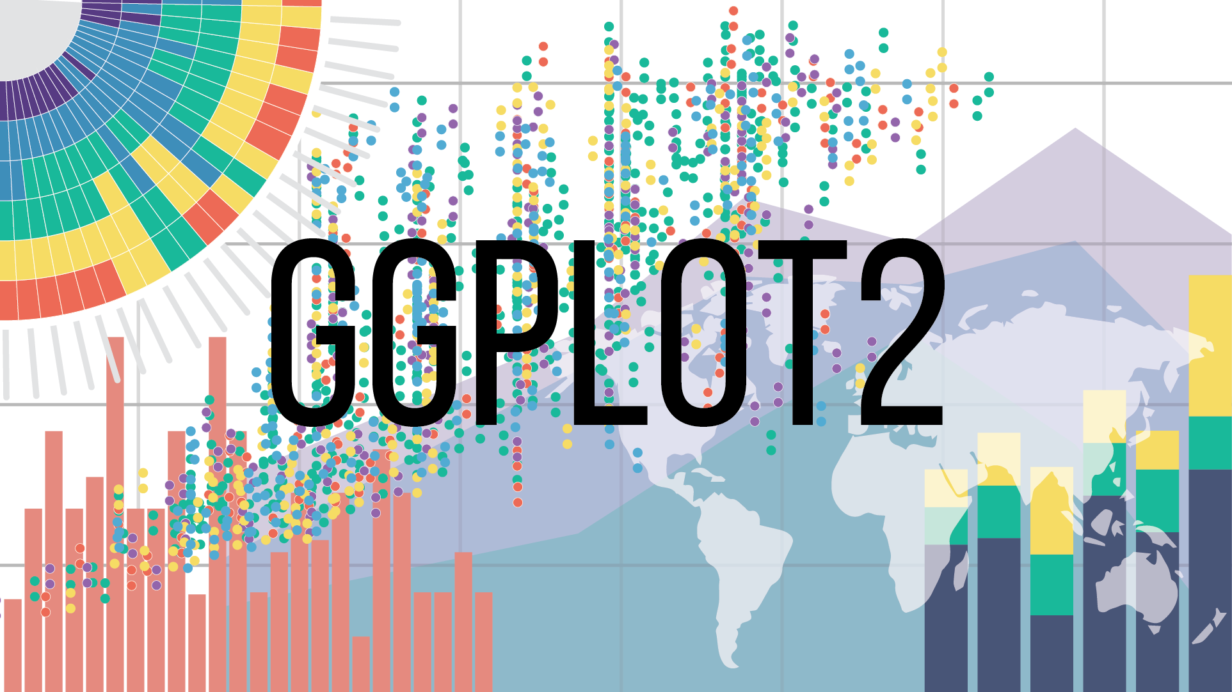
Visualization using ggplot2
ggplot2 is a system for declaratively creating graphics, based on The Grammar of Graphics
Standard visualization in the data science industry
Design quality graphics in seconds
Fine grained control for layering graphical elements

Slide 20
Grammar of Graphics - A good grammar will allow us to gain insight into the composition of complicated graphics, and reveal unexpected connections between seemingly different graphics
Data: Raw material for visualization
Layers: What you see on the plots e.g. Bars, lines
Scales: Maps data to the graphical output
4. Coordinates: Visualization perspective
5. Faceting: Provide “visual drill-down” into the data
6. Themes: Control details of the display e.g. background, fonts

Slide 21
Application of grammar in ggplot2
3 basic aspects
Data: Must have
Aesthetics: Map data (x= , y= )
Layers: What would you like? (geom_bar)

Slide 22


Slide 23
Prerequisites
Install R & R studio
Install ggplot2 package on your environment
install.packages(ggplot2)
Repository on GitHub has files for the source, data and slides
URL:

